Slide 1
Functions Overview

Slide 2
Functions in C++
It is better to develop and maintain large programs in the form of smaller pieces (modules)
This technique Called “Divide and Conquer”
Better Development Approach
A Development Approach
main()
{
-----
}
main()
{
-----
-----
.
.
.
----
-----
-----
return 0;
}
Easier To >>
Design
Debug
Extend
Modify
Understand
Reuse
function f1()
{
---
---
}
function f2()
{
---
---
}

Slide 3
Functions in C++(Cont.)
In C++ modules Known as Functions & Classes
Programs may use new and “prepackaged” or built-in modules
New: programmer-defined functions and classes
Prepackaged: from the standard library

Slide 4
About Functions in C++
Functions invoked by a function–call-statement which consist of it’s name and information it needs (arguments)
Example:
Boss
Main
Worker
Worker
Worker
Function Z
Function A
Function B
Sub-Worker
Sub-Worker
Note: usually main( ) Calls other functions, but other functions can call each other
Function B1
Function B2

Slide 5

Calling Function
Function calls:
Provide function name and arguments (data); Function performs operations and; Function returns results

Slide 6
Calling Functions
Functions calling (Syntax):
<function name>
(<argument list>);
e.g.,
FunctionName( ); FunctionName(argument1); FunctionName(argument1, argument2, …);
. . .

Slide 7
Calling Functions
Examples (built-in, and user-defined functions)
int n = getPIValue( ) ; //takes no argument
A user-defined function
cout << sqrt(9); //takes one argument, returns square-root
cout<<pow(2,3); //calculates 2 power 3
cout<<SumValues(myArray); //returns sum of the array
A user-defined function

Slide 8
Function Definition
Syntax for function definition:
returned-value-type function-name (parameter-list)
{
Declarations of local variables and Statements;
…
}
Parameter list
Comma separated list of arguments
– Data type needed for each argument
If no arguments → leave blank
Return-value-type
Data type of result returned (use void if nothing will be
returned)

Slide 9
Function Prototype
Before a function is called, it must be declared first.
Functions cannot be defined inside other functions
A function prototype is a function declaration without implementation:
int multiplyTwoNums(int,int);
A Function prototype (declaration without implementation)

Slide 10
Function Prototype (cont.)
Why it is needed?
It is required to declare a function prototype before the function is called.

Slide 11
Function Prototype (cont.)
int main() {
int sum = AddTwoNumbers(3,5); cout<<sum;
return 0;
Error: Un-defined function
}
int AddTwoNumbers(int a, int b) { int sum = a+b;
return sum;
}

Slide 12
Function Prototype (cont.)
Solution-1 Solution-2
int AddTwoNumbers(int a, int b) { int sum = a+b;
return sum;
}
int AddTwoNumbers(int, int);
int main() {
int sum = AddTwoNumbers(3,5); cout<<sum;
return 0;
}
int main() {
int sum = AddTwoNumbers(3,5);
cout<<sum;
return 0;
}
int AddTwoNumbers(int a, int b) {
int sum = a+b;
return sum;
}

Slide 13
Function signature and Parameters
Function signature is the combination of the function name and the parameter list.
Variables defined in the function header are known as
formal parameters.
When a function is invoked, you pass a value to the parameter. This value is referred to as actual parameter or argument.

Slide 14
Function’s return values
A function may return a value:
returnValueType is the data type of the value the
function returns.
c
If function does not return a value, the
returnValueType is the keyword void.

Slide 15


Calling Functions
c
Pass the value i
Pass the value j
int max(int,int); int main()
{
int i = 5;
int j = 2;
int k = max(i, j);
cout << "The maximum between "
<< i << " and " + j + " is "
<< k;
return 0;
}
int max(int num1, int num2)
{
int result;
if (num1 > num2) result = num1;
else
result = num2;
return result;
}

Slide 16
Calling Functions
c
i is now 5
Pass the value i
Pass the value j
int max(int num1, int num2)
{
int result;
if (num1 > num2) result = num1;
else
result = num2;
return result;
int max(int,int); int main()
{
int i = 5;
int j = 2;
int k = max(i, j);
cout << "The maximum between "
<< i << " and " + j + " is "
<< k;
return 0;
}
}

Slide 17
Calling Functions
c
j is now 2
Pass the value i
Pass the value j
int max(int,int); int main()
{
int i = 5;
int j = 2;
int k = max(i, j);
cout << "The maximum between "
<< i << " and " + j + " is "
<< k;
return 0;
}
int max(int num1, int num2)
{
int result;
if (num1 > num2) result = num1;
else
result = num2;
return result;
}

Slide 18
Calling Functions
c
Call max(5, 2)
Pass the value i
Pass the value j
int max(int,int); int main()
{
int i = 5;
int j = 2;
int max(int num1, int num2)
{
int result;
int k = max(i, j);
if (num1 > num2) result = num1;
else
result = num2;
cout << "The maximum between "
<< i << " and " + j + " is "
<< k;
return 0;
}
return result;
}

Slide 19
Calling Functions
c
Now num1=5 num2=2
Pass the value i
Pass the value j
int max(int,int); int main()
{
int i = 5;
int j = 2;
int k = max(i, j);
int max(int num1, int num2)
{
int result;
if (num1 > num2) result = num1;
else
result = num2;
return result;
cout << "The maximum between "
<< i << " and " + j + " is "
<< k;
return 0;
}
}

Slide 20
Calling Functions
c
A new variable result will be created (local to the max function)
Pass the value i
Pass the value j
int max(int,int); int main()
{
int i = 5;
int j = 2;
int k = max(i, j);
int max(int num1, int num2)
{
int result;
if (num1 > num2) result = num1;
else
result = num2;
return result;
cout << "The maximum between "
<< i << " and " + j + " is "
<< k;
return 0;
}
}

Slide 21
Calling Functions
c
5 > 2 → true condition
Pass the value j
int max(int num1, int num2)
{
int result;
if (num1 > num2) result = num1;
else
result = num2;
return result;
Pass the value i
int max(int,int); int main()
{
int i = 5;
int j = 2;
int k = max(i, j);
cout << "The maximum between "
<< i << " and " + j + " is "
<< k;
return 0;
}
}

Slide 22
Calling Functions
c
result = 5
Pass the value j
int max(int num1, int num2)
{
int result;
if (num1 > num2) result = num1;
else
result = num2;
return result;
Pass the value i
int max(int,int); int main()
{
int i = 5;
int j = 2;
int k = max(i, j);
cout << "The maximum between "
<< i << " and " + j + " is "
<< k;
return 0;
}
}

Slide 23
Calling Functions
c
return 5
Pass the value j
int max(int num1, int num2)
{
int result;
if (num1 > num2) result = num1;
else
result = num2;
return result;
Pass the value i
int max(int,int); int main()
{
int i = 5;
int j = 2;
int k = max(i, j);
cout << "The maximum between "
<< i << " and " + j + " is "
<< k;
return 0;
}
}

Slide 24
Calling Functions
c
k = 5
Pass the value i
int max(int,int); int main()
{
int i = 5;
int j = 2;
int k = max(i, j);
cout << "The maximum between "
<< i << " and " + j + " is "
<< k;
return 0;
}
Pass the value j
int max(int num1, int num2)
{
int result;
if (num1 > num2) result = num1;
else
result = num2;
return result;
}

Slide 25
Calling Functions
c
Display “The maximum between 5 and 2 is 5”
Pass the value i
Pass the value j
int max(int,int); int main()
{
int i = 5;
int j = 2;
int k = max(i, j);
int max(int num1, int num2)
{
int result;
if (num1 > num2) result = num1;
else
result = num2;
cout << "The maximum between "
<< i << " and " + j + " is "
<< k;
return 0;
}
return result;
}

Slide 26
Calling Functions
c
main function ends
Pass the value i
int max(int,int); int main()
{
int i = 5;
int j = 2;
int k = max(i, j);
cout << "The maximum between "
<< i << " and " + j + " is "
<< k;
return 0;
}
Pass the value j
int max(int num1, int num2)
{
int result;
if (num1 > num2) result = num1;
else
result = num2;
return result;
}

Slide 27
Function Overloading
c
Function overloading
Functions with same name and different parameters
Should perform similar tasks:
i.e., function to square int and function to square
float values
int square(int x)
{
return (x * x);
}
float square(float x)
{
return (x * x);
}

Slide 28
Function Overloading
c
At call-time C++ complier selects the proper function by examining the number, type and order of the parameters

Slide 29
Function Overloading
c
void print(int i)
{ cout << " Here is int " << i << endl; }
void print(double f)
{ cout << " Here is float " << f << endl; }
void print(char c)
{ cout << " Here is char" << c << endl; }
int main()
{ print(10);
print(10.10); print(‘Y’); }

Slide 30
Default Function Arguments
c
A value auto assigned by compiler (if not provided by user)
After default argument, all remaining function arguments must be default arguments
Example….

Slide 31
Default Function Arguments - Example
c
int sum(int x, int y, int w=1, int z=2) {
return (x+y+w+z);
}
int main() {
cout<<sum(2,3); cout<<sum(2,3,4);
//sum will be: 8
//sum will be: 11
cout<<sum(2,3,4,5); //sum will be: 14
return 0;
}

Slide 32
Scope of a Variable
The scope of a variable: the part of the program in which the variable can be accessed
Note: A variable cannot be used before it is defined
Example:…

Slide 33
Scope of a Variable
Different levels of scope:
Function scope
block scope
File scope
Class scope
Local variables
Global variables

Slide 34
Scope of a Variable - Example
c
Formal parameters and variables declared within
a function body are local to that function:
Cannot be accessed outside of that function
Memory (for function add)
int add(int A, int B){ int sum = a+b; return sum;
}
A
B
sum

Slide 35
Scope of a Variable - Example
c
Global variables with same name:
int sum=55; Iint main() {
…
}
Global Memory
sum
55
void display()
{
int sum = 66;
cout<<sum; // Display 66
}
Memory (for function display)
sum
66

Slide 36
Scope of a Variable - Example
c
Global variables with same name:
int sum=55; void main()
{
…
}
void display()
{
int sum = 66;
Global Memory
sum
55
Memory (for function display)
sum
66
cout<<::sum; // Display 55
}

Slide 37
Visibility of a Variable
A variable is visible within its scope, and
invisible or hidden outside it.

Slide 38
Lifetime of a Variable
The lifetime of a variable is the interval of time in which storage is bound to the variable.
The action that acquires storage for a variable is called allocation.

Slide 39
Lifetime of Variables
Local Variables (function and block scope) have lifetime of the function or block
Global variable (having file level scope) has
lifetime until the end of program
Examples…

Slide 40
Static Variables

Slide 41
Scope
Different levels of scope:
Function scope
block scope
File scope
Class scope
Local variables
Global variables

Slide 42
Lifetime of Variables
Local Variables (function and block scope) have
lifetime of the function or block
Global variable (having file level scope) has
lifetime until the end of program
Examples…

Slide 43
Static Variables
Static Variables:
Is created at the start of program execution
A static variable has scope of local variable
But has lifetime of global variables
Therefore, static variables retain their contents or
values (until the program ends)
If not initialized, it is assigned value 0 (automatically by the compiler)

Slide 44
Static Variables - Example
In the following example, the static variable sum is
initialized to 1
static int sum = 1;
Initialization takes place only once.
If declaration in a user-defined function:
First time the function is called, the variable sum is
initialized to 1.
Next time the function (containing the above declaration) is executed, but sum is not reset to 1.

Slide 45
Home Exercise (Using Static Variable)
c
Write a function that, when you call it, displays a message telling how many times it has been called: “I have been called 3 times”, for instance. Write a main() program that ask the user to call the function, if the user presses ‘y’ the function is called otherwise if ‘n’ is pressed the program terminates.
NOTE: Do not use any global variable or pass any value in the function

Slide 46
Arrays

Slide 47
One Dimensional Array
Collection of components
All of the same type
Structure given a single name
Individual elements accessed by index indicating relative position in collection
Index of an array must be an integer

Slide 48
Declaring Array Variables
datatype arrayName[arraySize];
Example:
double myList[10];
Array Size: MUST BE constant
- constant literal
- constant identifier
int size = 4;
double myList[size]; // Wrong
const int size = 4;
double myList[size]; // Correct
double myList[20]; // Correct

Slide 49
Input/Output of Array elements
Array elements are accessed through the index.
Array indices are 0-based;
int marks[3];
marks[0] = 76;
marks[1] = 65;
marks[2] = 27;
for(int i=0;i<3;i++)
cin>>marks[i];
for(int j=0;j<3;j++)
cout<<marks[j];
cout<<marks[2]<<marks[0]<<marks[1];

Slide 50
Initializing an Array
Declaring, creating, initializing in one step:
dataType arrayName[Size] = {value0, value1, ..., valuek};
Example:
int myList[4] = {32, 11, -6, 65};

Slide 51
Implicit Size
C++ allows you to omit the array size
For example, the following declaration is fine/correct:
int myList[ ] = {63, 9, 3, 13};
C++ automatically figures out how many elements are in the array.
int myList [ ]; // WRONG

Slide 52
Partial Initialization
C++ allows you to initialize a part of the array.
double myList[4] = {1.9, 4.65}; //correct
- The above example assigns values 1.9, 4.65 to the first two elements of the array.
- The other two elements will be set to zero.

Slide 53
Initializing arrays with random values
Following loop initializes the array myList with random values between 0 and 99:
int myList[10];
for (int i = 0; i < 10; i++)
{
myList[i] = rand() % 100;
cout<<“\nArray Element”<<i<<“ has val:”<<myList[i];
}
Notes:
rand() function is an inbuilt function in C++ STL, which is defined in header file <cstdlib>. rand() is used to generate a series of random numbers.

Slide 54
C-Strings or Character Arrays
The elements of an array can be just about anything (any-datatype)
Consider an array whose elements are all characters (char type)
Called a C-String
Treated differently for I/O than other types of arrays

Slide 55
Declaration of C-Strings
Similar to declaration of any array:
char name[30]; // no initialization
char title[20] = “Hello World";
//initialized at declaration with a string
char chList[6] = {‘H', ‘e', ‘l', ‘l‘, ’o’}; //initialized with list of char values

Slide 56
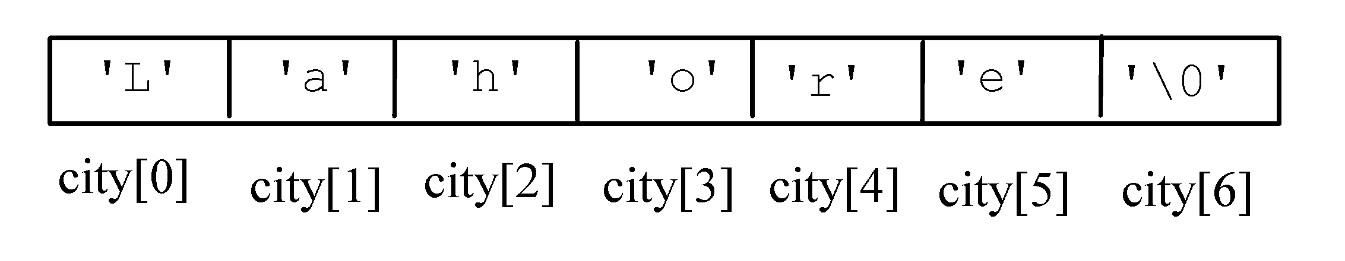
Initializing Character Arrays
char city[ ] = “Lahore";

Slide 57
Printing Character Array
For a character array, it can be printed using one print statement.
Character arrays are handled differently than other types of arrays
For example:
char city[ ] = “Lahore";
cout << city; // Correct

Slide 58
Character Array (string) Input
Declare strings 1 element bigger than planned size to allow for ‘\0’ (null character)
char city[10];
cin>> city; //User enters Islamabad
When input takes place, C++ automatically places the ‘\0’ in memory at the end of the characters typed in

Slide 59
Two Dimensional Arrays

Slide 60
Two Dimensional Arrays
A two dimensional array stores data as a logical collection of rows and columns
Each element of a two-dimensional array has a row position and a column position (indicated by two indexes)
To access an element in a two-dimensional array, you must specify the name of the array followed by:
a row index
a column index

Slide 61
Declaration and Initialization
A consecutive block of (row size)*(column size) memory locations are allocated.

Slide 62
Declaring Arrays
datatype arrayName[rowSize][coulmnSize];
Example:
double myList[2][4];
rowSize, and coulmnSize: MUST BE constant
- constant literal
- constant identifier

Slide 63
Example
//Declaration
int data[2][3];
col 0
col 1
col 2
row 0
? | ? | ?
? | ? | ?
row 1

Slide 64
Declaring and Initializing Arrays
int myList[3][2] = {{22,33}, {44,55}, {66,77}};
🡪 myList has 3 Rows and 2 coulmns in each row
🡪 In memory:
Coulmn Indexes
0 1
0
1
2
22 | 33
44 | 55
66 | 77
Row Indexes

Slide 65
Initialization Examples
int temp[4][3] = {{50, 70, 60}, {48, 75, 62}, {51, 69, 60}, {52, 78, 63}};
int t2[7][4] = {{50, 70, 60, 90}, {48, 75, 62, 43}, {51, 69, 60, 21}, {52, 78, 63, 65},
{48, 75, 62, 43},{51, 69, 60, 21},
{52, 78, 63, 65}};
int temp[][3] = {{50, 70, 60}, {48, 75, 62}, {51, 69, 60}, {52, 78, 63}};

Slide 66
Example: Input Using cin
Nested for loops are often used when inputting and assigning values to a two-dimensional array.
//Declaration
double table[5][10];
for (int i=0; i<5; ++i) //every row
for (int j=0; j<10; ++j ) //every col
cin >> table[i][j];

Slide 67
Example: Computations
Compute the average value of an matrix with n rows and m columns.
double sum=0;
double average;
for (int i=0; i<n; i++) //every row
for (int j=0; j<m; j++ )//every col
sum += array[i][j];
average = sum / (n*m);

Slide 68
Example: Computations
Compute the average value of the 3rd row of a 2D array with r rows and c columns.
double sum=0;
double rowAverage;
for (int j=0; j<c; j++) //every col
sum += array[2][j];
average = sum / c;

Slide 69
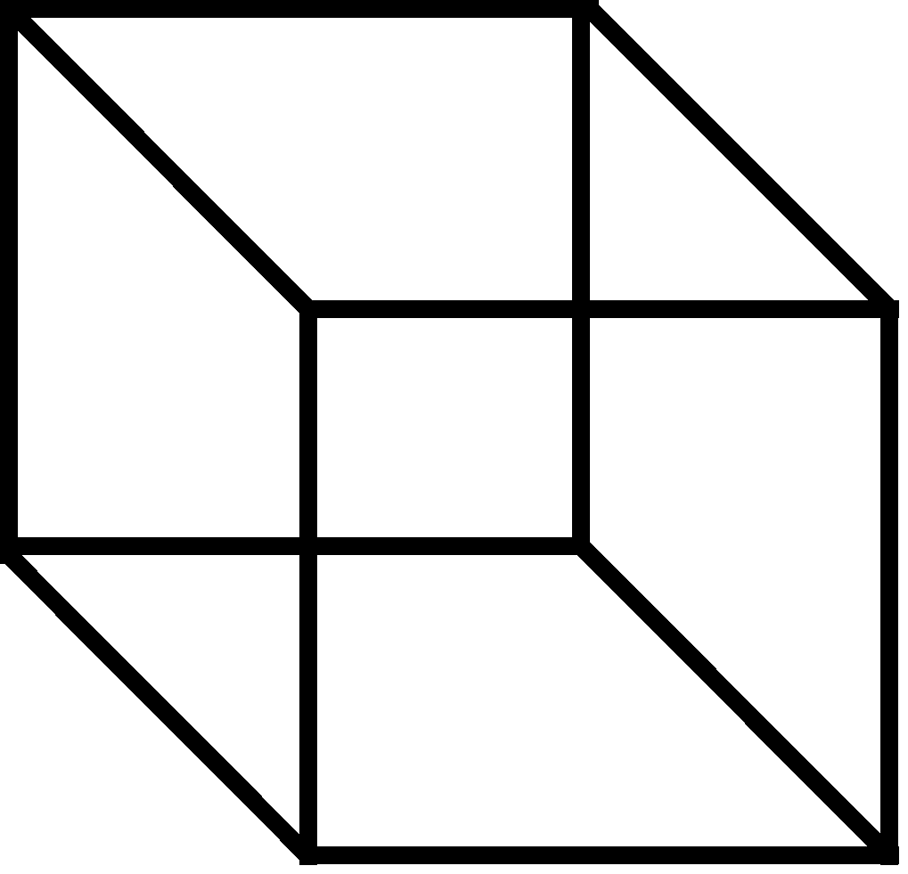
Higher-Dimensional Arrays
- An array can be declared with multiple dimensions.
2 Dimensional 3 Dimensional
double Coord[100][100][100];
- Multiple dimensions get difficult to visualize graphically.
•
Single
value
1D Array
2D Array
3D Array

Slide 70
Larger-Dimension Arrays
Arrays with more than two dimensions allowed in C++ but not commonly used
Example: int response[4][10][6];
First element is response[0][0][0]
Last element is response[3][9][5]

Slide 71
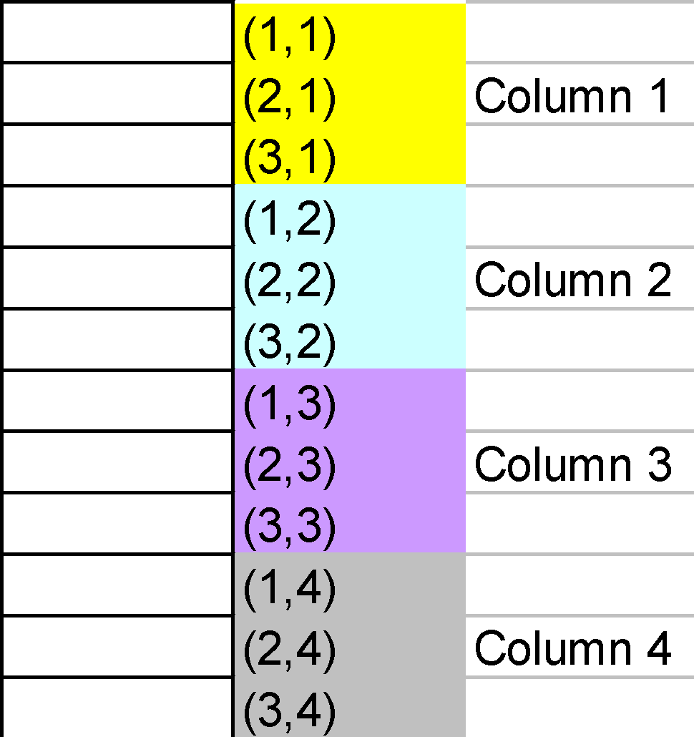
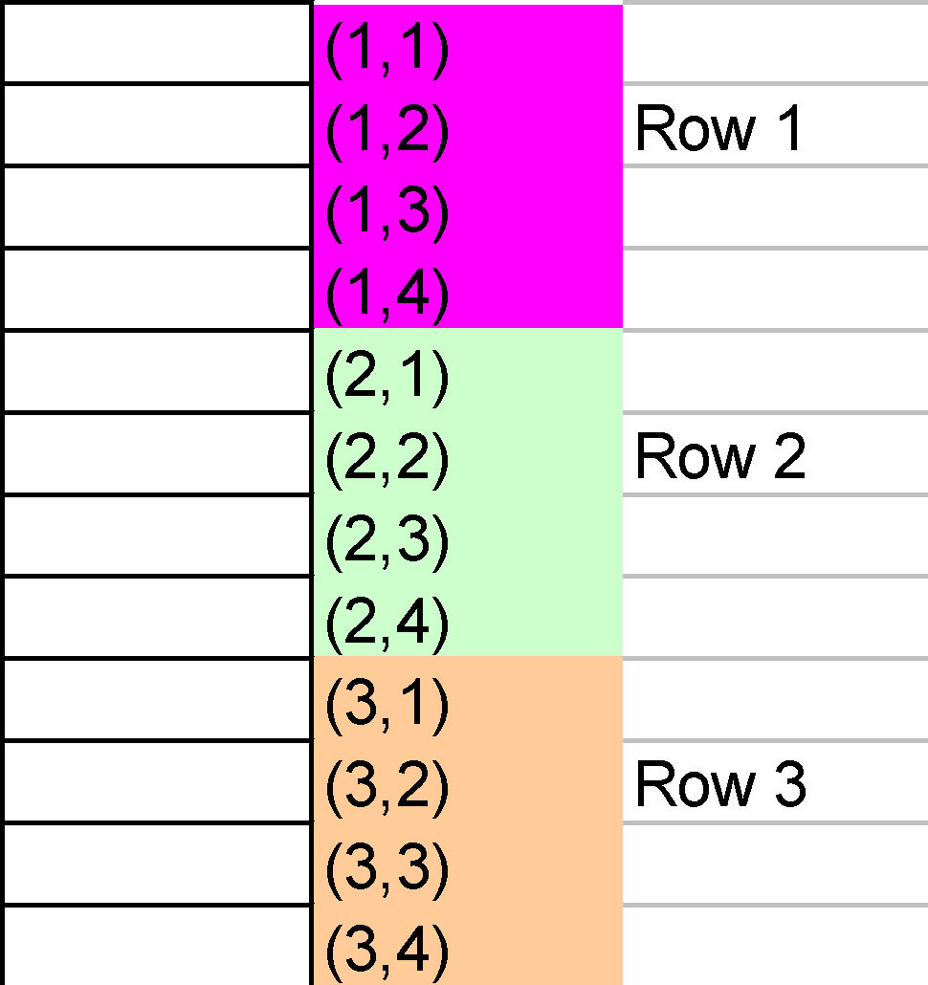
Two Dimensional Arrays in Memory(C++)
Two ways to be represented in memory
Column by column 🡪 column majored
Row by row 🡪 row majored
Representation depends upon the Programming language used

Slide 72
Analysis of Arrays
How to insert an item?
How many steps in terms of N (number of elements in array)?
N steps at maximum (move items to insert at given location)
How to delete an item?
How many steps in terms of N (number of elements in array)?
N steps at maximum (move items back to take place of deleted item)

Slide 73
Analysis of Arrays
How to search an item?
Linear Search
Binary Search
Searching and Sorting (Next Lecture)

Slide 74
Home Programming Tasks (Arrays)

Slide 75
(Nested Loops) – Example Program-1
Write a program to that creates a matrix of size 5 by 5 (5 Columns, and 5 Rows). The program should ask the user to enter values in each matrix element. Then the program should display the matrix Row-wise.
Example:
1, | 2, | 3, | 4,
5, | 6, | 7, | 8,
9, | 10, | 11, | 12,
13, | 14, | 15, | 16,
1 | 2 | 3 | 4
5 | 6 | 7 | 8
9 | 10 | 11 | 12
13 | 14 | 15 | 16
Output

Slide 76
(Nested Loops) – Example Program-2
Write a program to that creates a matrix of size 5 by 5 (5 Columns, and 5 Rows). The program should ask the user to enter values in each matrix element. Then the program should display the matrix Coulmn-wise.
Example:
1, | 5, | 9, | 13,
2, | 6, | 10, | 14,
3, | 7, | 11, | 15,
4, | 8, | 12, | 16,
1 | 2 | 3 | 4
5 | 6 | 7 | 8
9 | 10 | 11 | 12
13 | 14 | 15 | 16
Output

Slide 77
(Nested Loops) – Example Program-3
Write a program to that creates a matrix of size 10 by 10 (10 Columns, and 10 Rows). The program should ask the user to enter values in each matrix element. Then the program should display the left-diagonal elements of the matrix.
Example (5 by 5 matrix):
1 | 2 | 3 | 4
5 | 6 | 7 | 8
9 | 10 | 11 | 12
13 | 14 | 15 | 16
Output
1, | 6, | 11, | 16,

Slide 78
Example-4: Zero Matrix
Write a program that creates a matrix of 3 by 3 (3 rows, and 3 coulmns). Get input values from the user for the complete matrix. Then, the program should determine whether the matrix is a “Zero” matrix (all elements are zero) or not.

Slide 79
Example-5: Coulmn sum
Write a program that creates a matrix of 4x4 (4 rows, and 4 coulmns). Get input values from the user for the complete matrix. The program should calculate and print the sums of each individual coulmn.

Slide 80
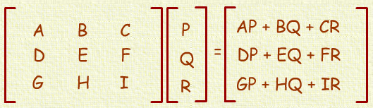
Example-6: Matrix Vector
Write a program that creates a matrix of 3 by 3 (3 coulmns, 3 rows). Create a vector/array having 3 elements. The program should multiply the matrix with the given vector and print the resultant matrix in proper format.

Slide 81
Example-7: Matrix-Matrix Multiplication
Write a program that creates 2 matrices of 10 by 10 (10 columns, 10 rows). Initialize both of the matrices with random values. Then multiple and store the result in Matric C (10 by 10 size). In the end, print the resultant matrix in proper format.

Slide 82
Example-8: Sparse Matrix-Matrix Multiplication
Write a program that creates 2 Sparse matrices of 10 by 10 (10 columns, 10 rows). Initialize both of the matrices with random values. Then multiply and store the result in Matric C (10 by 10 size). In the end, print the resultant Sparse matrix in proper format.

